Slide 1
SBAC Mid-Year Check-in

Slide 2
Agenda
Procedural, General Business & Updates (25 Minutes)
Guest introductions and sign-in sheet
Acting Secretary: Tom Lamar
VOTE: Approve May, June Minutes
New member applications- Kevin McGrath and Alex Frieden
Charlie leaving
Burning Questions (AFTER you have read all the updates on the 5’ E’s Spreadsheet:-)
Focus Section (45 Minutes)
Mid-year check-in on our priorities for the year- Ken 15’
What do we want to get done in the rest of 2017? Ken 15’
Vision Zero- plans and what it will mean Adam 15’
Engineering Committee Update/ Help Needed (20 Minutes)
Engineering
Other E’s-- what’s one big goal for next month and help that you need to accomplish it?
Banter over Beer: Location TBA
What are the low hanging fruit we should pick this year?

Slide 3
July 2017: How are we doing as a Committee?
Membership: 12, 11 current members, 2 candidates elect, 2 more candidates interested
Ex officio members: Only two attend regularly (Mike, Steve)
Coordination with the City
Strong connection/coordination with OSPCD
Weak connection with DPW, T&P and Engineering
Better connectivity with Aldermen
Have not succeeded in getting an audience with the Mayor this year
Five “E” Teams
Leadership changes in three of the Teams (Kevin, Katie, and Alex are new leaders this year)
Teams working well and getting things done
Most teams meet monthly
All could use more members
Bike Month Events- strong presence (Kick-off Event, RHC, Bike Talks)

Slide 4
2017 Highest Priorities (set in January)
Bike safety involving all Five E’s (bike advocacy panel, web site safety info)
Webster Ave improvements (laid advocacy groundwork, parking studies)
Ensuring bike mobility/safety during Union Sq. construction
Ensuring bike mobility/safety during Beacon St construction and ensuring final design
Elm/Cedar/Mossland St bike plan (ongoing)

Slide 5
2017 Low Hanging Fruit (set in January)
Contra flow on Marshall St and Roseland St
Bike Lane on School St from Medford to Highland
Release updated Bike Map
Increased communication with Aldermen
Get City to conduct a Transportation Survey (planned for fall)
Promotion/enforcement of 25mph speed limit, creation of 20mph safety zones, and enforcement of no parking in bike lanes
Educate Beacon St residents about how to interact with the cycle track

Slide 6
July 2017: Things we’re proud of:
Evaluation
Neighborways focus (and adding Mark as a member!) BS, GS, EK
Working with City to make sure Beacon St cycle track gets built right BS, AF
Encouragement
Building a coalition of supporters for Webster Ave PBL project TL, KM, KC, MC, SW, CD
Successful Rush Hour Challenge AA
Education
Bike Safety mailings sent out with the parking permits AE, LW
Pushing city for bike safety around construction areas (Beacon St last winter) EB
Enforcement
Working with city to use VMB’s to get out bike safety messages IW
Letter to Ride Share companies KP
Shortening our meetings!!

Slide 7
July 2017: Things we’d like to accomplish this year
Continued focus on Bike Safety
Evaluation/Engineering
Webster Ave PBL’s AE, GS, KC, KM, AF, CD
Beacon St PBL’s from Washington St to Inman Sq AE, KC
Better bike facilities on Elm Street (climbing lane from Somerville Ave to Cedar) IW, AE, LW
Better data capture (e.g. before/after data on Washington St betw. McGrath and Union) MC
Pop-up PBL’s AA
Safety improvements for Powderhouse Square EB
Follow through on re-surfacing projects (e.g. Broadway, Medford St) TL
Education/Enforcement
Bike safety and mobility during Webster Ave reconstruction KP
Organize a workshop with SPD to educate bicyclists and motorists sharing the road EK
More 20 mph speed zones (e.g. Elm St near Porter Sq, Holland St in Davis Sq) LW
Beacon St cycletrack education SW

Slide 8
July 2017: Low Hanging Fruit
Evaluation/Engineering
Marshall St contra flow KC
Sycamore St contra flow AE
Cedar Street contra flow BS
Roseland St two way for bikes AA
Add westbound bike lane on Medford St (Walnut to Pearl St) TL
Buffered bike lane on Medford St between Somerville Ave and Cambridge line MC
Add “Except Bikes” signs to “No Turn on Red” signs TL
Add plastic bollards on Elm St right turn to Cutter and then Cutter on to Summer AA
Priority List of projects MC
Encouragement
Ensure good bike accommodations in the revised zoning code TL
Get city to adopt Winter snow plow policy IW, KM
Education/Enforcement
Create and distribute postcard flyers about sharing the road EK
Get listed on People for Bikes list of local bike groups EB
Parking ban on Park/Dane St as needed during Beacon St construction CD

Slide 9
SBAC Engineering Team July 2017
Somerville Bicycle Committee

Slide 10
Cedar Street Concept
Improve bicycle network/ permeability by creating contra-flow lane

Slide 11
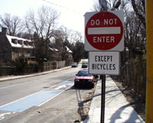
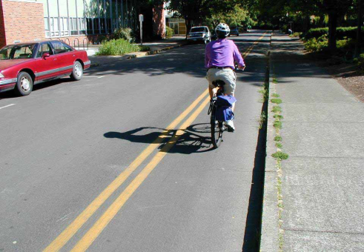
1- way Cedar Street: Elm to Highland
+
Existing
Proposed
Parking line
One-way
One-way
NE to
Highland Ave; uphill
5’ colored
advisory bike
lane
18’ travel
8’ parking
7’ parking
5’
9’
5’ colored
contraflow
curbside lane*
*add traffic signal heads facing contraflow bicycle traffic at Summer St and Highland Ave
26’
26’

Slide 12
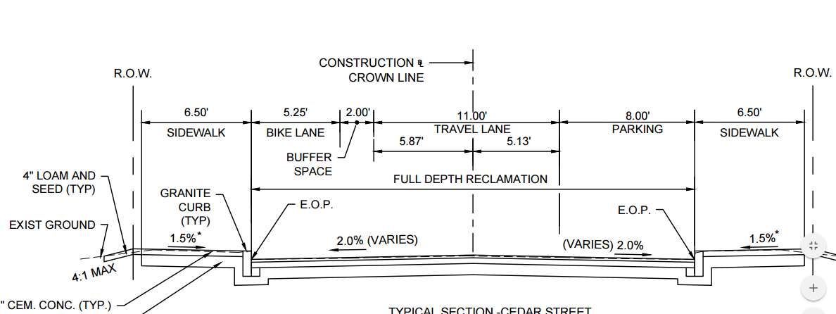
Existing design

Slide 13
Recent design proposal
Contra
Flow
5’
4.5’
9.5’
7’
Advisory

Slide 14
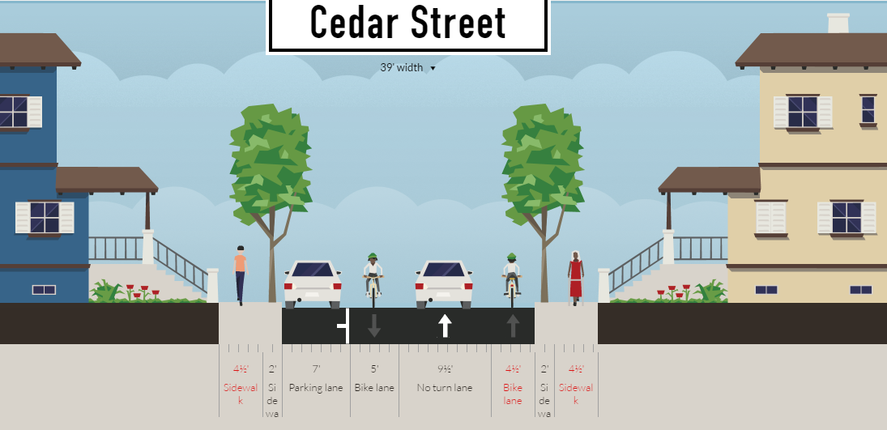
Contra
flow
Conceptual striping plan with contra-flow bike lane. The with traffic bike lane could be as narrow as 4 feet and the half foot could be added to the vehicle or contra-flow lane depending on design goals.

Slide 15
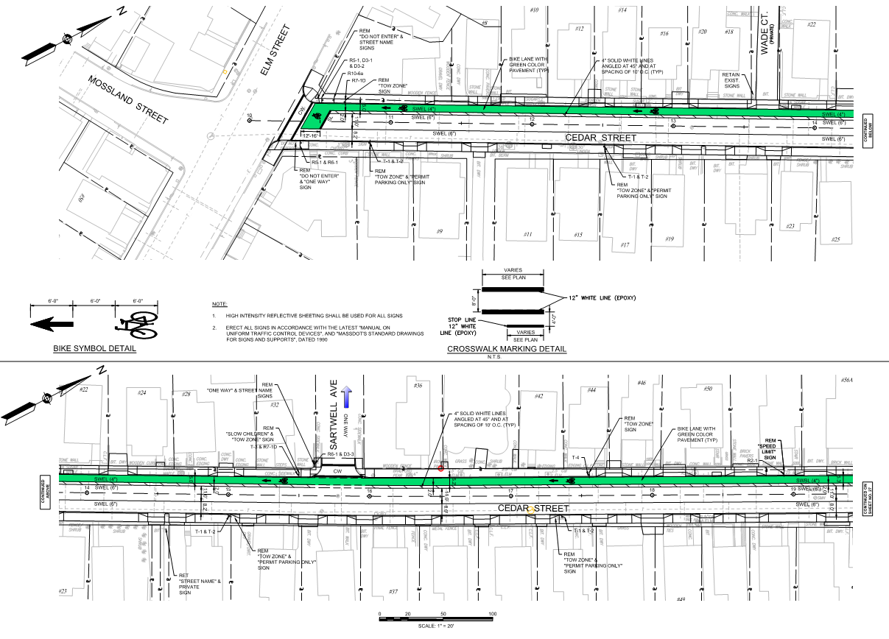

Slide 16
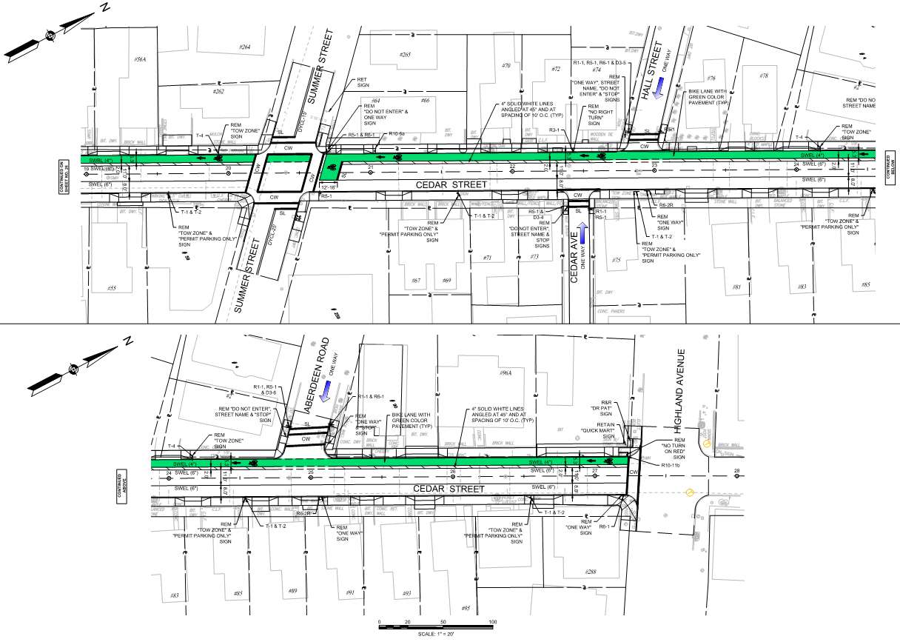

Slide 17
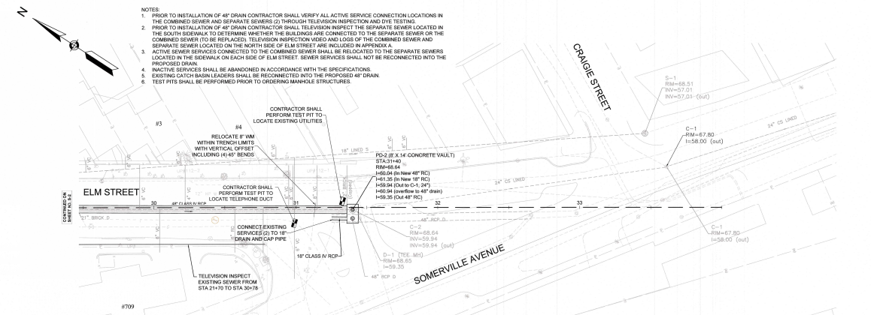
Elm St (Cedar to S’ville Ave)
Climbing lane?
Or Intersection lane?

Slide 18
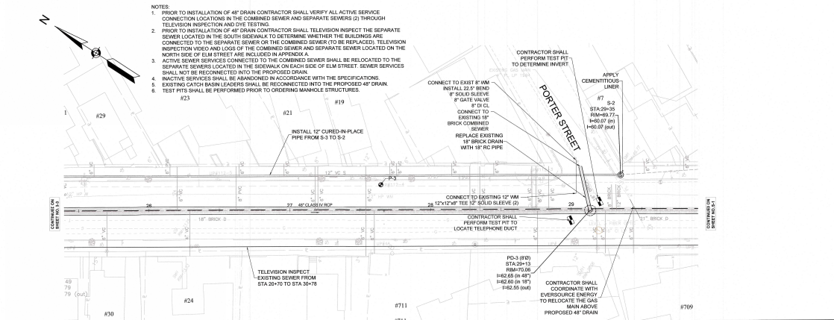
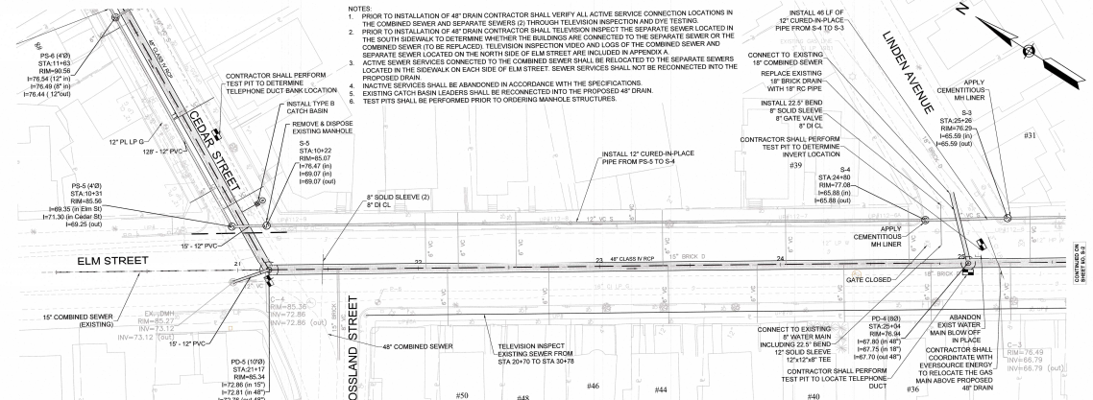

Slide 19
Mossland Street: reduced parking
+
+
Proposal A:
One side of parking removed
Existing
12’ shared lane
7’
5’
9’
5’
7’ parking
7’ parking
Parking line
One-way
1-side parking
2-sides parking
NE to Elm Street
Somerville Avenue Intersection
Somerville Avenue Intersection
5’ colored
contraflow
curbside lane*
26’ shared lane
8’
5’
8’
5’
26’
26’

Slide 20
Mossland Street: retained parking
+
Proposal B:
all parking retained
Existing
12’ shared lane
7’
5’
7’
7’
7’ parking
7’ parking
One-way
Parking line
5’ colored
advisory bike
lane
2-sides parking
One-way
2-sides parking
NE to Elm Street
Somerville Avenue Intersection
Somerville Avenue Intersection
26’ shared lane
10.5’
5’ bike lane
10.5’
26’
26’

Slide 21
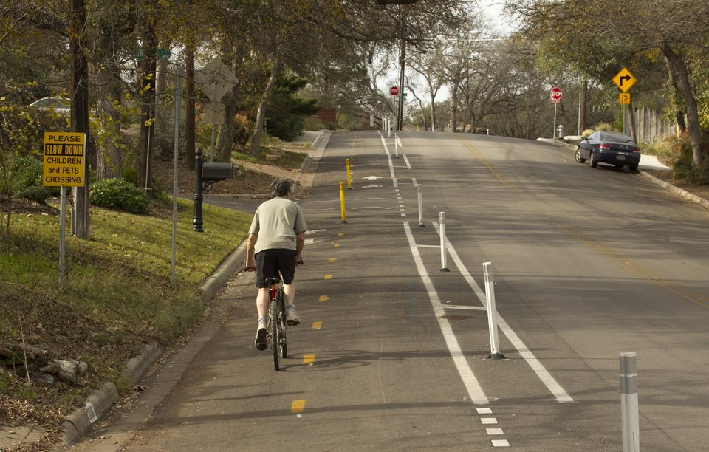
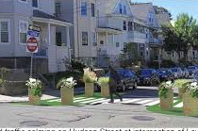
Powderhouse & College Avenue Protected Bicycle Lanes
Proposal for low cost/ low stress facilities
Two way cycle track Neighborway

Slide 22
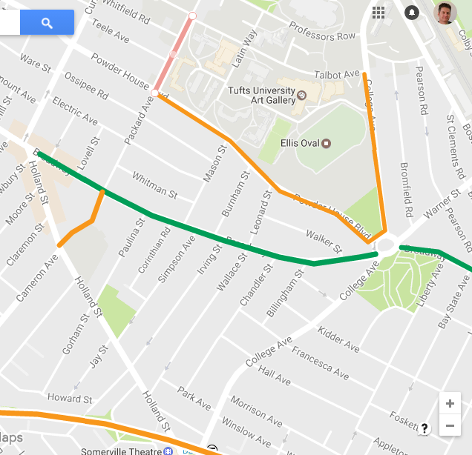
Legend:
Proposed two way cycle track (Approx 1 mile). The priority is College and Powderhouse. Packard would be nice if possible.
Packard Avenue Option
Existing bike lane (Somerville Network). This would extend the current network from Broadway further east and North
Also shown: Powderhouse school path and Community Path

Slide 23
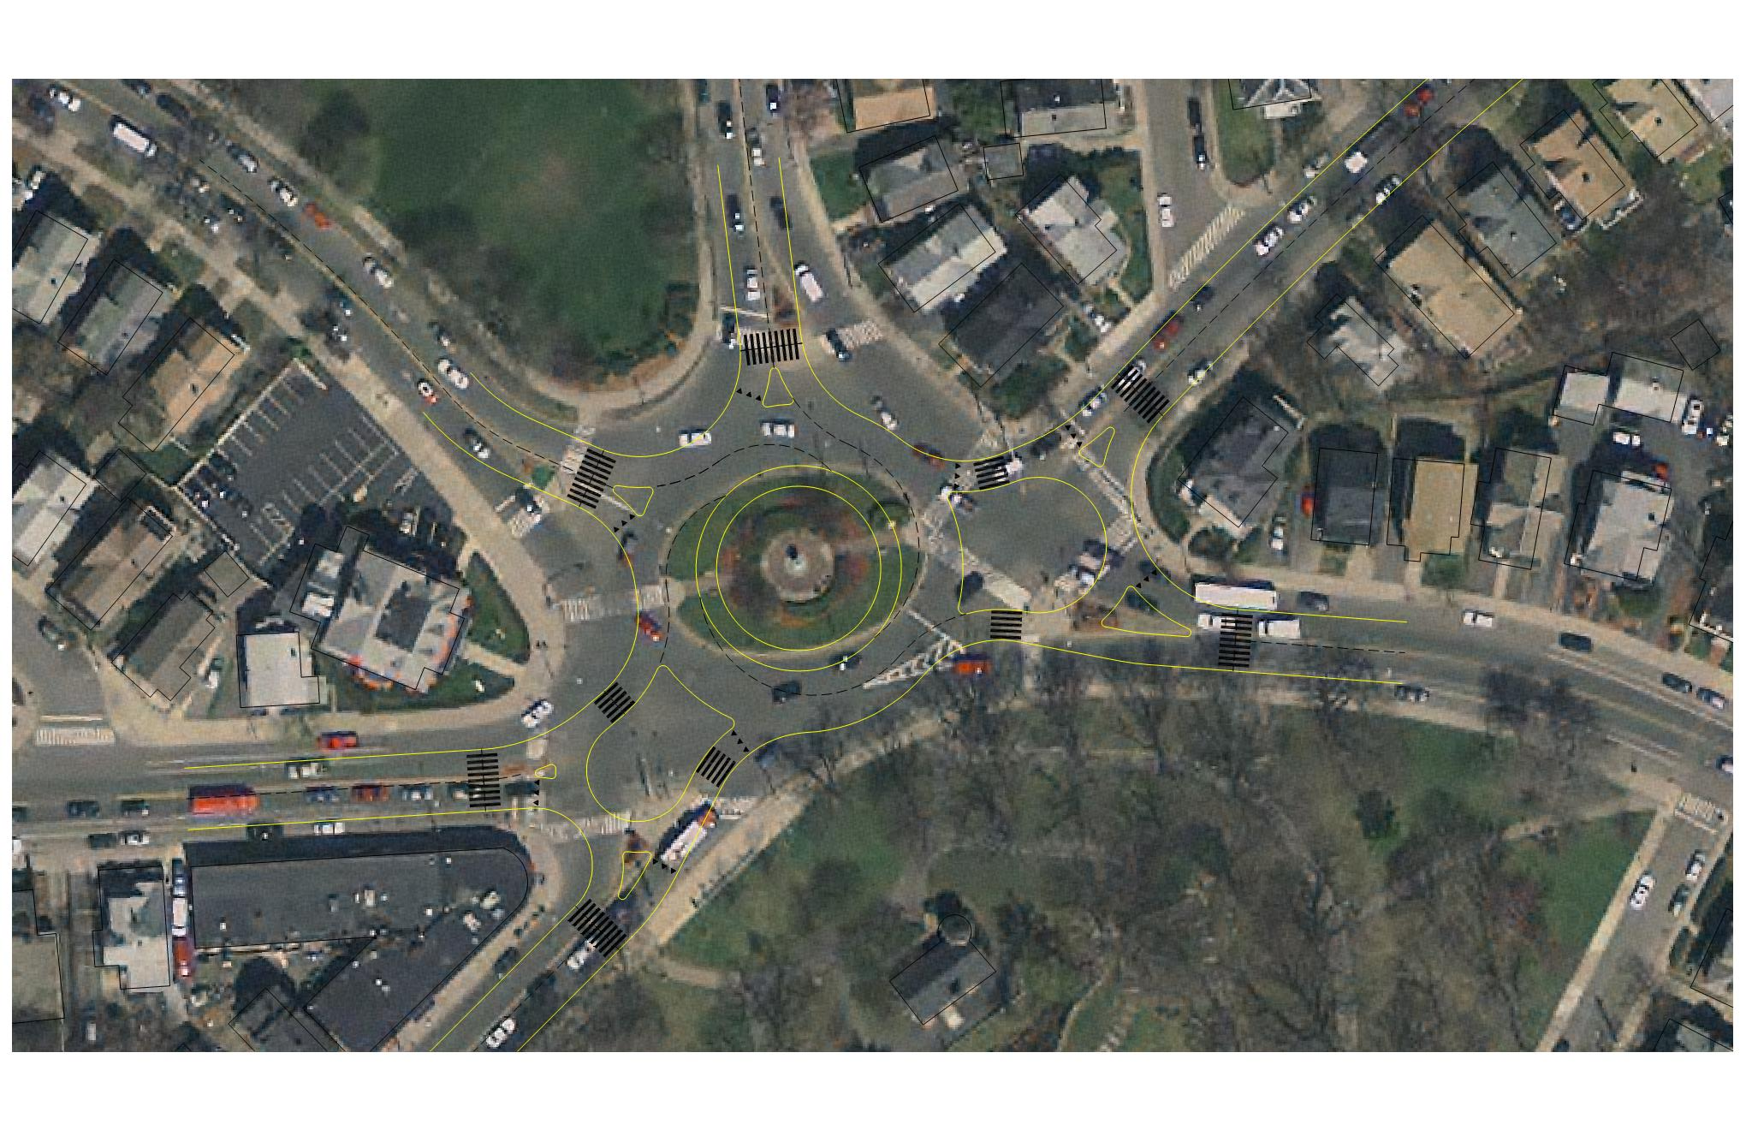
Powderhouse Square

Slide 24
Powderhouse Square

Slide 25
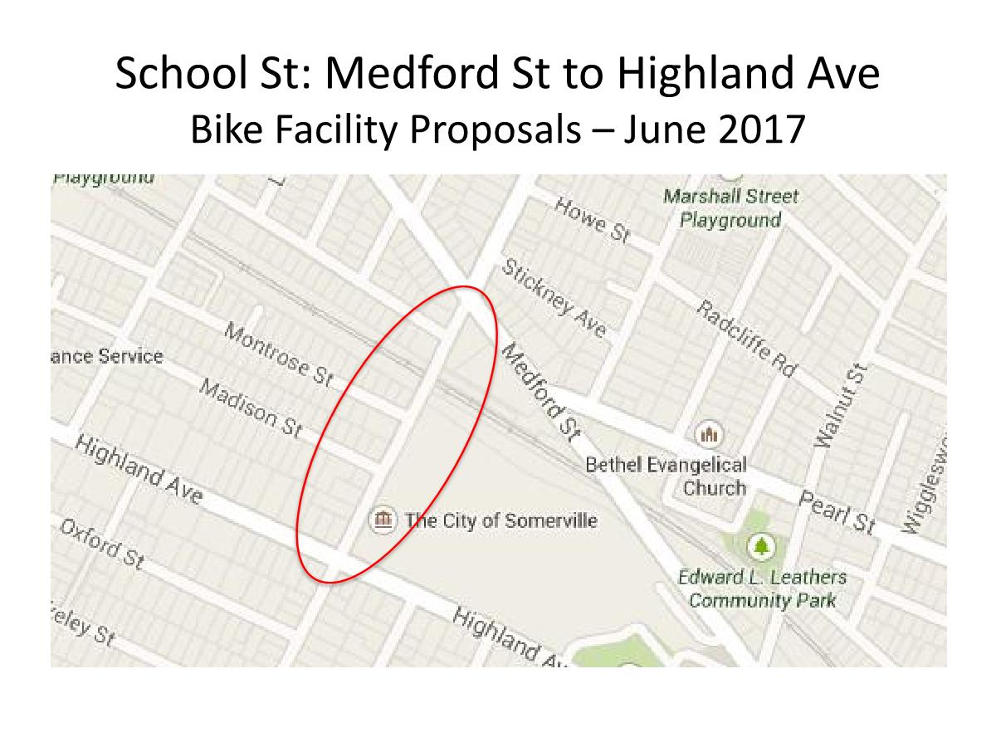

Slide 27
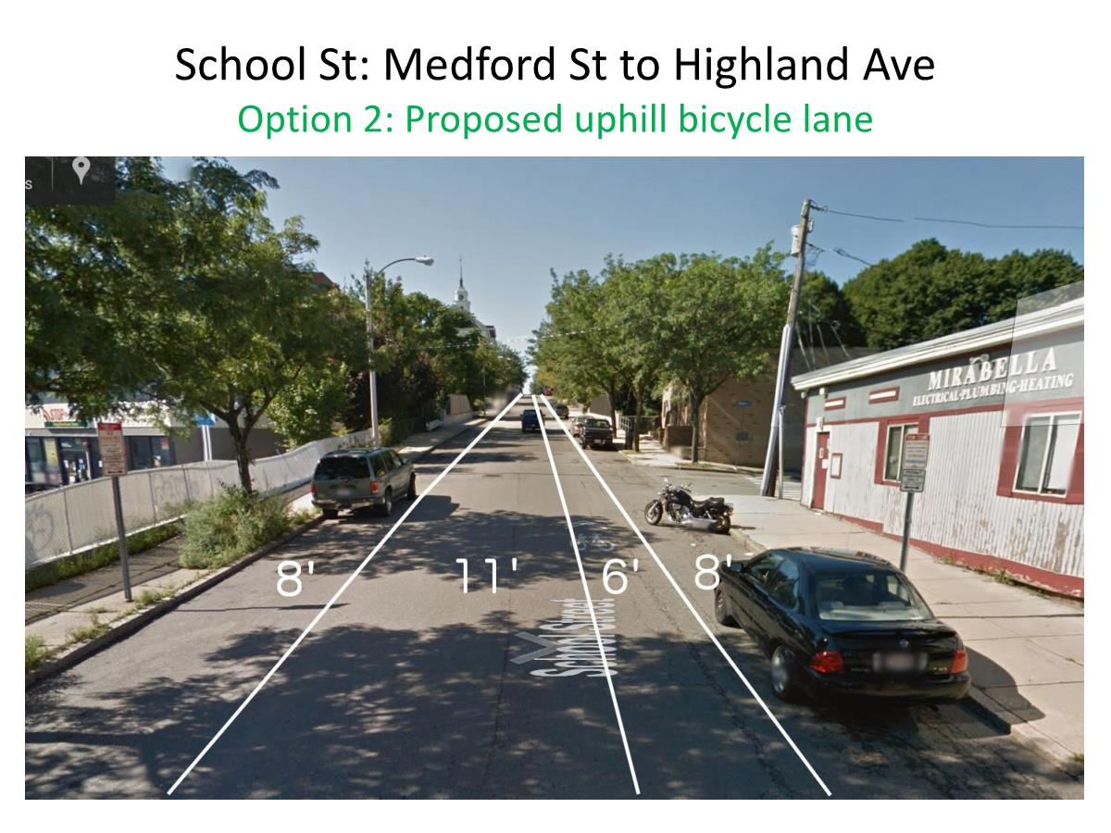

Slide 28
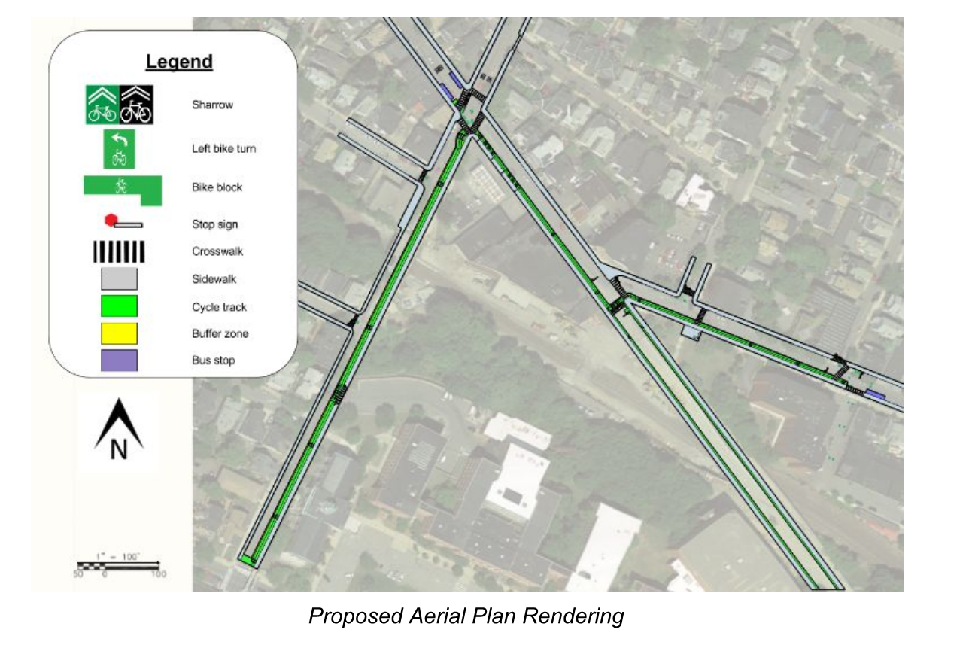
Gilman Square

